Slide 1

VBA for Excel

Slide 2
The Visual Basic Editor in Excel (VBE)
Setting up the Visual Basic Editor in Excel (VBE)
The VBE is a program within Excel that allows you to communicate with Excel.
On your keyboard press the "Alt+F11" key
When you first open the VBE you will see a window somewhat like the image below (next slide).
Notes:
Notes
Special note for users of Excel 2007: Until the 2007 versions of Excel the user did not need to install anything to work with macros in Excel. If you are using Excel 2007 see how to install the Visual Basic Editor for Excel from your Office CD.
IMPORTANT NOTE 1: There are no risks to your computer or to Excel in completing the task below. At any time if you feel uncomfortable, just close Excel without saving the workbook and try again later.
For users of Excel 1997 to 2006: The first thing that you need to do is to make sure that the security level of Excel is set at either "Low" or "Medium" so that you can use the macros (VBA procedures) that you develop. From the menu bar of Excel select "Tools" then "Macro" then "Security" and select "Medium".
For users of Excel 2007 to 2010: From the "Developer" ribbon click on the "Macro Security" button. Check the second level "Disable all Macros with Notification" and you are set.

Slide 3
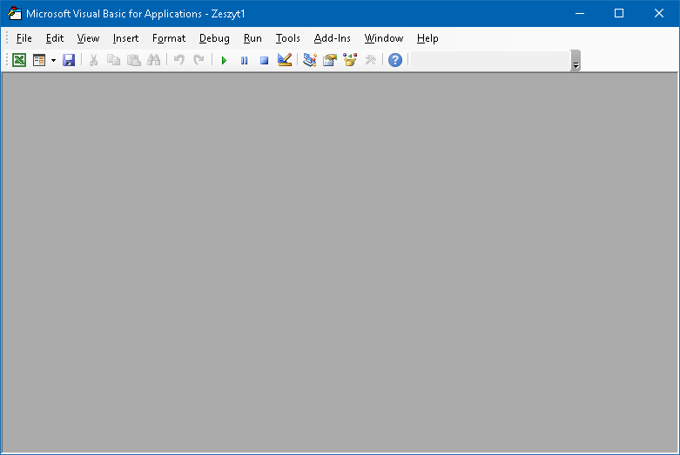
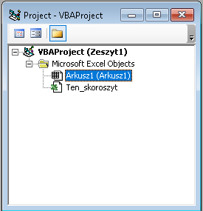
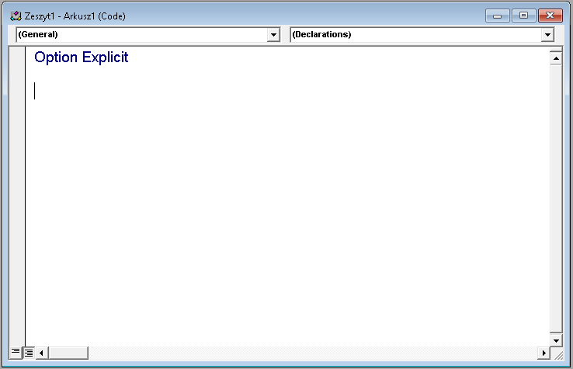
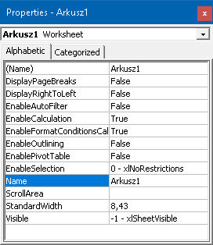
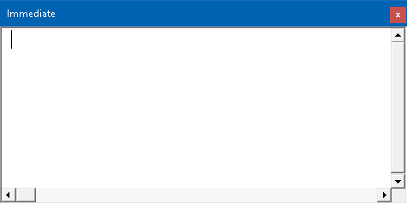
Code Window (F7)
Project Window (^R)
Properties Window (F4)
Immediate Win (^G)
F7
^R
F4
^G

Slide 4
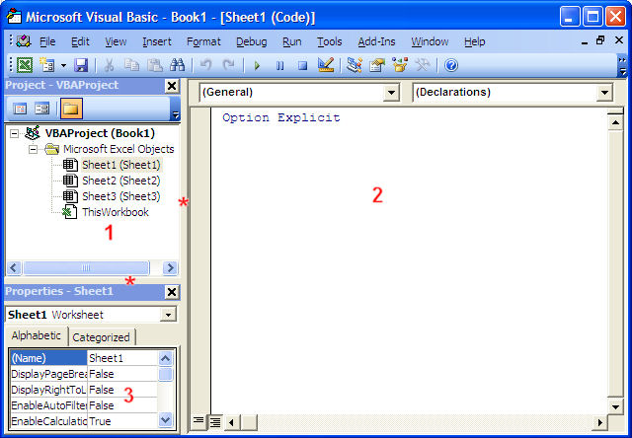
Windows in the Visual Basic Editor
When working with the VBE there should always be 3 windows showing like in the image below:
the Project Window (1), the Code Window ( 2),
the Properties Window (3),
arranged as in the image

Slide 5
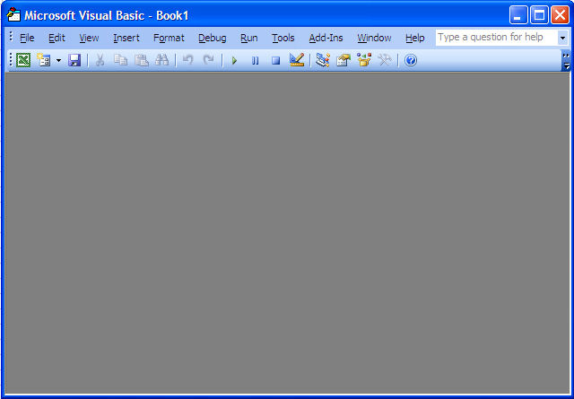
Exercise #1. Setup the 4 windows of the VBE.
Exercise 1 (Create your first macro and use it)
Step 1: Close all the windows that are open in the VBE to end up with this:

Slide 6
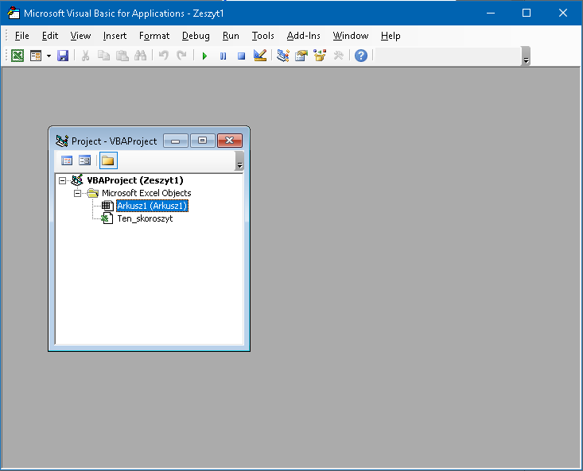
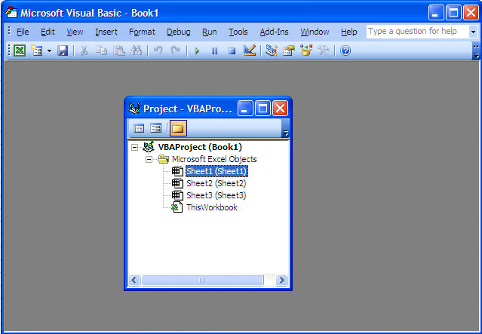
Step 2: Go to the menu bar "View" and click "Project Explorer" (^R).
The result will be somewhat like the image below:
or:

Slide 7
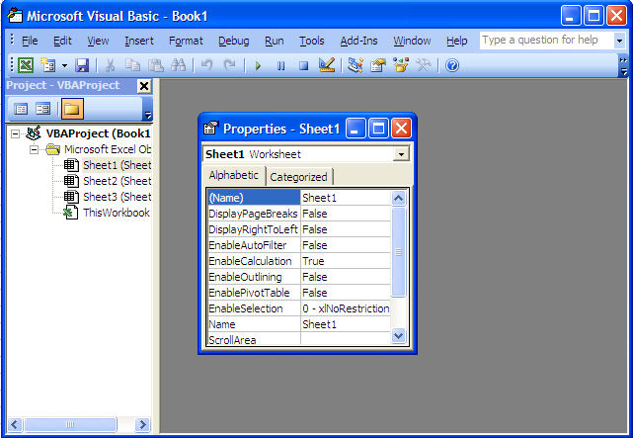
Step 3: In the menu bar "View" click "Properties Window" (F4)

Slide 8

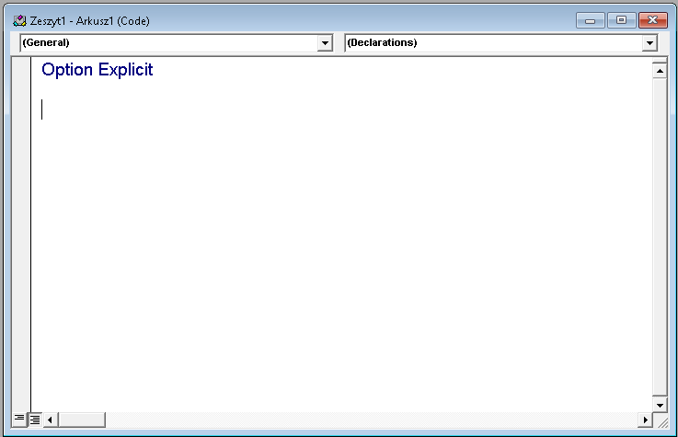
Step 4: To add the code window press F7 or you just have to double click on the name of a component in the Project window (Arkusz1, Arkusz 2, … or Ten_skoroszyt) and its code window appears within the gray rectangle.
Step 4b: To add the immediate window press ^G

Slide 9
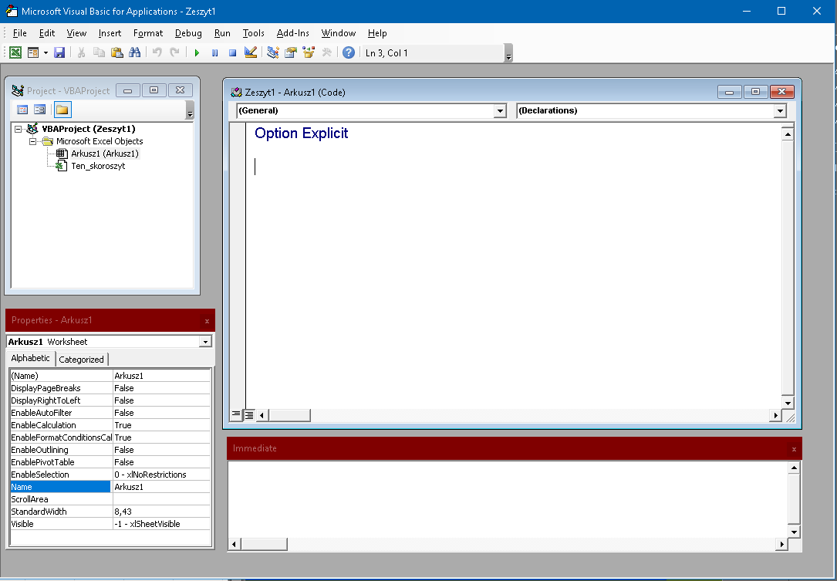
The final result looks like the image below

Slide 10

The
Project
Window

Slide 11
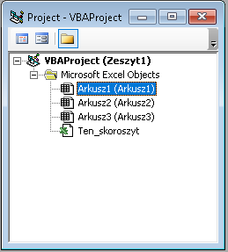
Project window (CTRL+R)
The Project window shows you all the workbooks that are open ("Zeszyt1") in the example below) & their components.
A new Excel workbook includes 3 sheets & component named "Ten_skoroszyt" (ThisWorkbook) in which you will store the macros (called VBA procedures) that should start automatically when the workbook is opened.

Slide 12
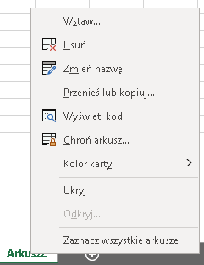
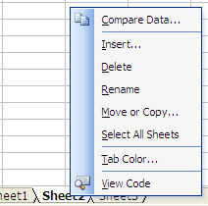
Working within the Project Window
Exercise (Create your first macro & use it)
Step 1: Using the ALT+F11 key go back to Excel.
Step 2: Add a sheet. Right-click on the tab of Sheet2 and select "Insert".
Step 3: In the dialog window that appears, click on "OK".
Notes:
Modules are folders in which you save one or many of your macros.
You can export and save these modules to be used later in other workbook.

Slide 13
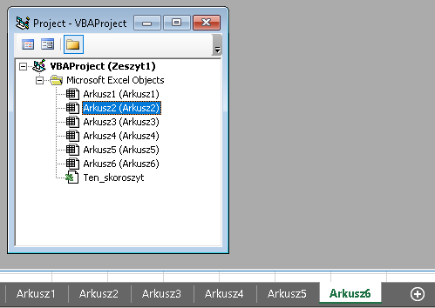
Step 4: Using Alt+F11 key, go back to the VBE and see that a sheet has been added to the workbook.
The worksheets are sorted alphabetically in the Project window

Slide 14
The
Properties
Window

Slide 15
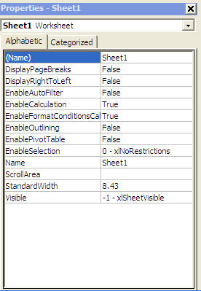
Properties window
The Properties window (F4) shows you the properties of the component that is selected in the Project Window (single click).
For example in the new workbook if you single click on "Sheet1" in the Project Window you see the properties of sheet1 in the Properties Window like in the image.
Notes:
As you can see, a worksheet has 12 properties that you can change in this Properties window. Notice that there are 2 "Name" properties. On the first line there is the programmatical name of the sheet (Sheet1). You will discover later the advantages and disadvantages of changing this property. The second "Name" property (9th line) is the name (or caption) that appears on the tab of the sheet in Excel.

Slide 16
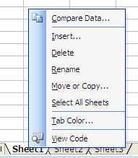
Changing the "Name" Property
Go to Excel (ALT/F11) and notice the names on the three tabs of "Sheet1" as in the image below.
We will change the name (Caption) on the tab of "sheet1" to "Introduction". To do so right-click on the tab of the sheet and the following dialog window appears:

Slide 17

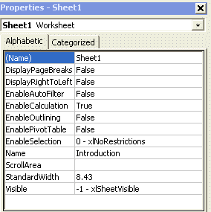
Changing the "Name" Property
Step 3: Select "Rename". The menu disappears and the name of Sheet1 is highlighted. Enter "Introduction" and this new name will replace "Sheet1" when you click "Enter". The end result is illustrated in the image below.
Step 4: Come back to the Visual Basic Editor (ALT/F11) and notice in the Properties window that the property "Name" (the ninth property, the one without the parentheses) has changed to "Introduction

Slide 18

The Code Window
is where ≈90% of the VBA work is done:
writing VBA sentences (subroutines)
testing your VBA procedures (macros)
modifying them when needed.

Slide 19
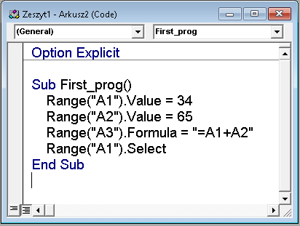
Exercise - Create your first macro & use it
Step 1: Notice that cells A1, A2 & A3 of „Arkusz1" are empty. Go to the VBE Step 2: Double click on „Arkusz1" in the Project Window. On the right is the Code window of „Arkusz1"
Step 3: Click anywhere in the Code window Step 4: Copy the following macro to the code win of „Arkusz1" or key it in.
Sub First_prog() Range("A1").Value = 34 Range("A2").Value = 65 Range("A3").Formula = "=A1+A2" Range("A1").Select End Sub
Notes:
Sub First_prog() Range("A1").Value = 34 Range("A2").Value = 65 Range("A3").Formula = "=A1+A2" Range("A1").Select End Sub

Slide 20
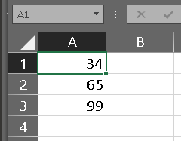
Exercise - Create your first macro & use it
Step 7
Step 5: Click on any line of the macro & press F5 key ("Run Sub/Userform”).
Step 6: Go to Excel (ALT/F11) & see what has happened to cells A1, A2 and A3
You have run and tested you first macro.
Go to Excel & „Arkusz1" and see that what the macro was ordering Excel to do has been done. The value of cell "A1" is 34, the value of cell "A2" is 65 and there is a formula in cell A3 that sums cells A1 and A2.
Step 7: Go to Excel & clear the cells A1, A2 and A3 of „Arkusz1". On the menu bar go to Developer ("Tool”) & click on "Macros" (Alt+F8). In the dialog window select "First_prog" and click on run.

Slide 21
Działania na komórkach arkusza Excel z VBE

Slide 22
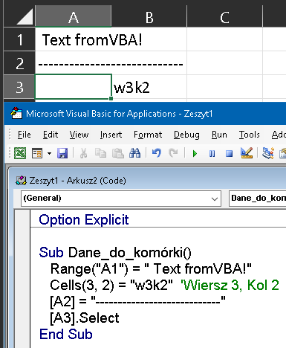
Adresowanie komórek arkusza – wpisywanie danych
Jeśli chcemy wykonywać działania na konkretnym arkuszu danych innym, niż ten, na którym się obecnie znajdujemy, aktywujemy go następującym kodem wskazując w cudzysłowie nazwę – w naszym wypadku Arkusz1:
Sheets("Arkusz1").Select
Jeśli chcemy wprowadzić dowolną wartość w komórkę arkusza, powinniśmy najpierw tą komórkę zaadresować. Dokonujemy tego poleceniem Cells(komórka) lub Range(zakres).
Poleceniem Cells adresujemy jedną komórkę, zaś Range adresuje zakres wielu komórek.
Jesteśmy już w konkretnym arkuszu. Oto najprostsze działania na pojedynczej komórce:
Range("A1") = „Text fromVBA"
Cells(3, 2) = "w3k2"
Odniesienia do innego arkusza:
Arkusz5.Range("A1") = "VBA5"
Arkusz5.Cells(2, 4) = "A5-w2k4"
Notes:
Sub Dane_do_komórki()
Range("A1") = " Text fromVBA!"
Cells(3, 2) = "w3k2" 'Wiersz 3, Kol 2
[A2] = "----------------------------"
[A3].Select
End Sub

Slide 23
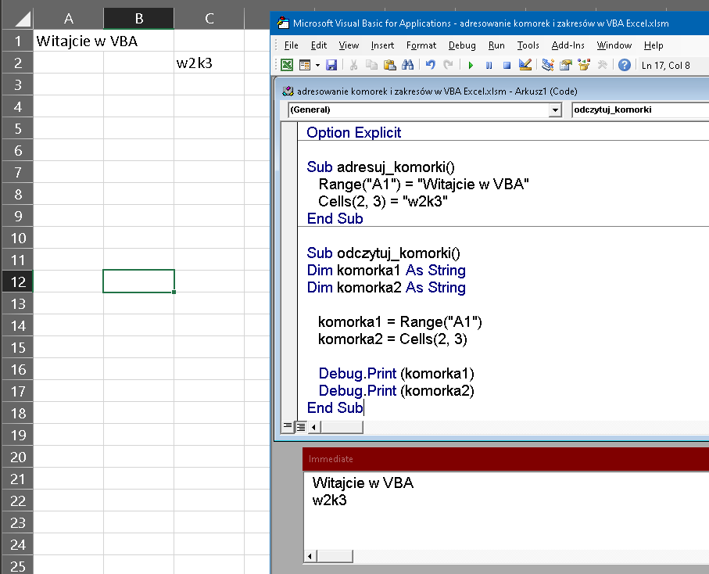
Adresowanie komórek – odczytywanie danych z arkusza

Slide 24
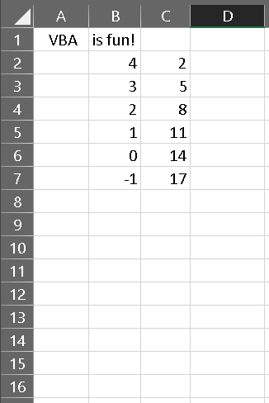
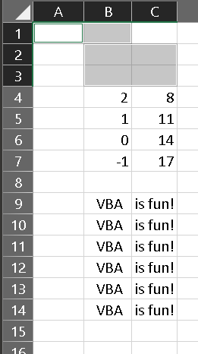
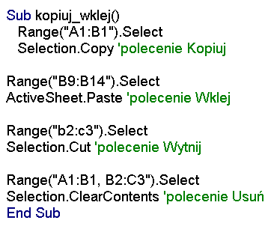
Manipulacja danymi w komórkach – kopiuj, wklej, wytnij, usuń
Notes:
Sub adresuj_komorki()
Range("A1") = "Witajcie w VBA"
Cells(2, 3) = "w2k3"
End Sub
Sub odczytuj_komorki()
Dim komorka1 As String
Dim komorka2 As String
komorka1 = Range("A1")
komorka2 = Cells(2, 3)
Debug.Print (komorka1)
Debug.Print (komorka2)
End Sub
Sub kopiuj_wklej()
Range("A1:B1").Select
Selection.Copy 'polecenie Kopiuj
Range("B9:B14").Select
ActiveSheet.Paste 'polecenie Wklej
Range("b2:c3").Select
Selection.Cut 'polecenie Wytnij
Range("A1:B1, B2:C3").Select
Selection.ClearContents 'polecenie Usuń
End Sub

Slide 25
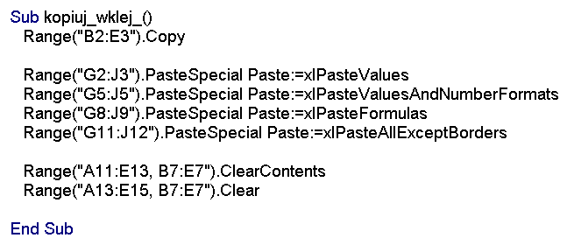
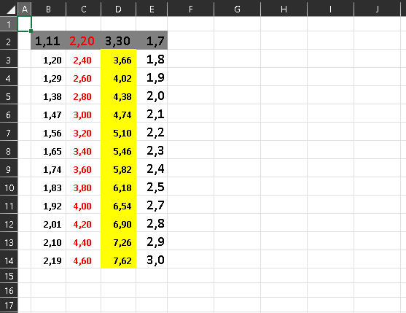
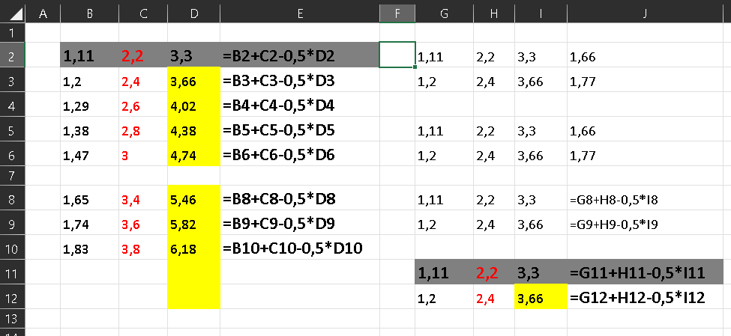
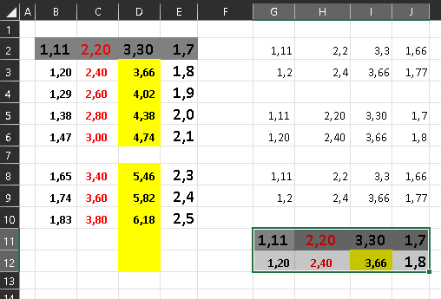
Manipulacja danymi w zakresach – kopiuj, wklej, wytnij, usuń
Notes:
Sub kopiuj_wklej_()
Range("B2:E3").Copy
Range("G2:J3").PasteSpecial Paste:=xlPasteValues
Range("G5:J5").PasteSpecial Paste:=xlPasteValuesAndNumberFormats
Range("G8:J9").PasteSpecial Paste:=xlPasteFormulas
Range("G11:J12").PasteSpecial Paste:=xlPasteAllExceptBorders
Range("A11:E13, B7:E7").ClearContents
Range("A13:E15, B7:E7").Clear
End Sub

Slide 26
Developing Macros
in Excel
Most macros are developed in the code window of modules

Slide 27
Exercise. Double click on „Arkusz1" in the project window
Enter sub proTest() without using a capital "S" as the beginning of "sub". After entering the closing parenthesis click on "Enter". You get these two lines of code:
Sub proTest()
End Sub
VBE adds the line "End Sub" & capitalizes the "S" of "Sub" . The VBE capitalizes letters appropriately when the word is spelled correctly. In this way, whenever VBE unexpected fails to capitalize a letter, you will know that something is wrong.
Two exceptions to your otherwise consistent use of lower-case are:
(1), when you declare variables and
(2), when you name macros (as you did above).
You may write a procedure within the two lines of code above:
Sub proTest()
Sheets("Arkusz1").Select Arkusz1 .Range("C1").Select
Do Until Selection.Offset(0, -2).Value = "" Selection.Value = Selection.Offset(0, -2).Value & " " & Selection.Offset(0, -1) Selection.Offset(1, 0).Select Loop
Arkusz1.Range("A1").Select End Sub
The procedure will go down column "C" & assemble the 1st names of column "A" & the last names of column "B". It will perform this task all the way down until there are no more first names in column "A"
Notes:
Sub proTest()
Sheets("Arkusz1").Select
Arkusz1.Range("C1").Select
Do Until Selection.Offset(0, -2).Value = ""
Selection.Value = (Selection.Offset(0, -2).Value & " " & Selection.Offset(0, -1).Value)
Selection.Offset(1, 0).Select
Loop
Arkusz1.Range("A1").Select
End Sub
Sub proTest2()
Sheets("Arkusz1").Select
Arkusz1.Range("C1").Select
While Selection.Offset(0, -2).Value <> ""
Selection.Value = (Selection.Offset(0, -2).Value & " " & Selection.Offset(0, -1).Value)
Selection.Offset(1, 0).Select
Wend
Arkusz1.Range("A1").Select
End Sub

Slide 28
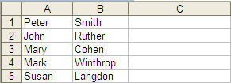
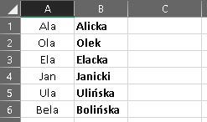
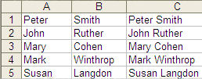
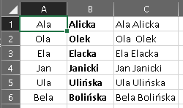
The procedure above will go down column "C" and assemble the first names of column "A" and the last names of column "B" with a space in between. It will perform this task all the way down until there are no more first names in column "A" . It will then place the cursor in cell "A1".
To test this macro (VBA procedure) follow the steps below:
Step 1: Go to Excel (ALT/F11) and enter first names in cell A1 to A5.
Step 2: Enter surnames in cells B1 to B5.
Step 3: Come back to the VBE (ALT/F11) and click within the macro in the code window.
Step 4: From the menu bar select "Run (F5)/Run Sub/Userform".
Step 5: Go back to Excel and see the result.
Notes:
You can erase everything in column C Excel and retry with more names and surnames.
Try it again removing the first name in cell A3. Notice that the macro stops on line 2.

Slide 29
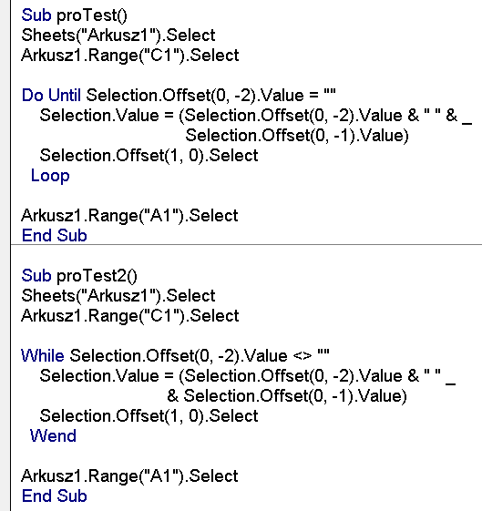
Notes:
You can erase everything in column C Excel and retry with more names and surnames.
Try it again removing the first name in cell A3. Notice that the macro stops on line 2.

Slide 30
Testing Macros
in Excel

Slide 31
Testing the VBA procedure step by step
NOTE: While you are running the macro step by step you can stop the execution at any time by clicking on the stop button in the toolbar:
During the development of a project you will use:
20% of your time analysing & designing
15% programming &
65% testing.
During the testing phase, you will correct bugs, typos and the logical errors. More importantly you will improve your original project, fine tune it, discover better ways to do things and add code.
You have created your first macro and tested it using the "Run" button. You can also test a macro step by step.
Open a new workbook & use ALT/F11 to open the VBE
Step 1: Go to Excel and make sure that cells A1, A2 and A3 of Sheet1 are empty.
Step 2: In VBE in the Code window of Sheet1 copy the following macro:
Notes:
Testing is the most time-consuming part of any VBA project.

Slide 32
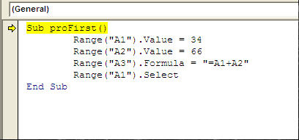
Sub proFirst() Range("A1").Value = 34 Range("A2").Value = 66 Range("A3").Formula = "=A1+A2" Range("A1").Select End Sub
Step 3: Click anywhere within the macro and then press the F8 key. VBE highlights the first line of code in yellow.

Slide 33
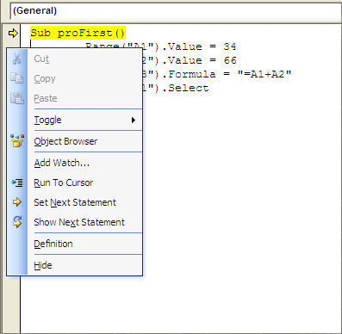
Right-click on the small yellow arrow and see a menu appear

Slide 34
Step 5: Press on "F8" a 2nd time. No line has been executed yet & if you go to Excel you will see that cells A1 to A3 are still empty. The next time you press "F8" , VBE will execute the yellow-highlighted line.
Step 6: Press "F8" a 3rd time. The yellow-highlighted line is now "Range("A2").Value = 65". VBE has executed the previous line "Range("A1").Value = 34" has been executed so if you go to Excel (ALT/F11) you will see 32 in cell A1.
Step 7: Come back to VBE & press "F8" again. Go to Excel and see what happened in cell A2.
Step 8: Come back to VBE & press "F8". Go to Excel & see that there is a formula in cell A3.
Step 9: Come back to the VBE (ALT/F11) and press "F8" again, cell A1 is now selected.
Step 10: Press "F8" again. Nothing happens in Excel but "End Sub" is highlighted in yellow
Step 11: Press "F8" again. Nothing happens, no more lines in VBE are highlighted in yellow.
The macro has been tested, the test is over.

Slide 35
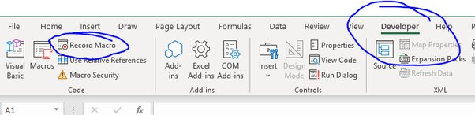
Macro
Recorder

Slide 36
Excel Macro Recorder
When you start the macro recorder
anything you do in Excel is recorded as a new macro.
That makes the macro recorder the best VBA teacher and also a great assistant who will write a lot of the words and sentences. It will also be there when you do not remember something that you do not use often. Even after many years of programming you will still use the macro recorder daily not to learn anymore but to write code.
Recording Your First New Macro:
Step 1: Open Excel and a new workbook.
Step 2: Go to the "Developer" ribbon to click on

Slide 37
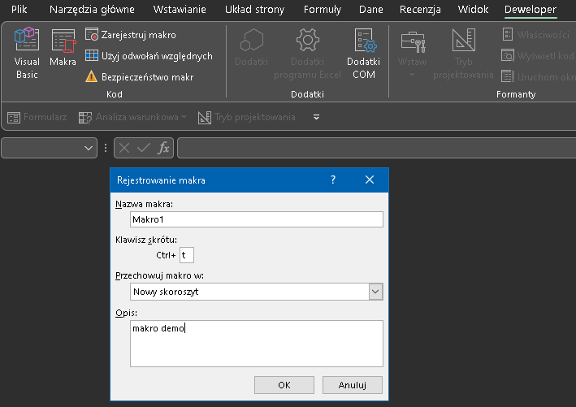
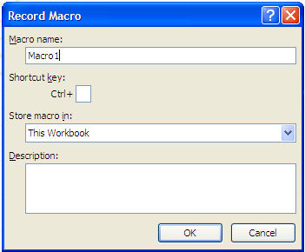

Excel Macro Recorder
Step 3: A small window appears titled
"Record Macro".
When you do so the small window disappears and in the "Developer" ribbon
is replaced by
telling you that you are going in the right direction. The macro recorder is ON.
Step 4: In the sheet below (Sheet1) select cells B1 to B5, go to "Sheet2", select cell B6, come back to "Sheet1" and select cells D2 to D5.
Step 5: In the "Developer" ribbon click on

Slide 38
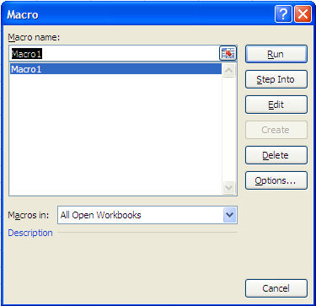
Macro Recorder - Running your first recorded macro
Step 1: Select cell "A1" of "Sheet1".
Step 2: In the "Developer" ribbon click on
Step 3: In the window that appears Macro1 is selected.
Step 4: See how fast the macro runs. You do not even see Excel go to Sheet2 (but it does). At the end of the execution cells D2 to D5 are selected.

Slide 39
Looking at your first recorded macro
Go to the VBE. You will see the following macro in the code win when you double click on Module 1 in the Project Window:
Sub Macro1()
Range("B1:B5").Select Sheets("Sheet2").Select Range("B6").Select Sheets("Sheet1").Select Range("D2:D5").Select End Sub
As you can see the macro recorder recorded your instructions in a language that Excel understands (VBA).

Slide 40
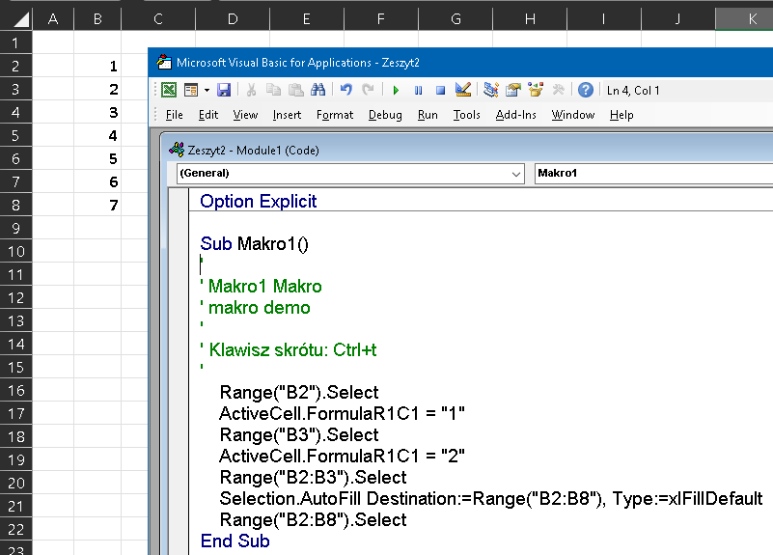
Looking at your first recorded macro

Slide 41
Macros Help
And
Assistance

Slide 42
Macros Help and Assistance
There is plenty of help and assistance available within Excel when you develop macros. As you have discovered the Macro Recorder is a great teacher and assistant. Now we investigate the two other sources of assistance within the VBE: the Help Files and the Object Browser.
Here is how the Object Browser (F2) appers when you call it. ALL the VBA words are presented in this tool including useful examples.

Slide 43
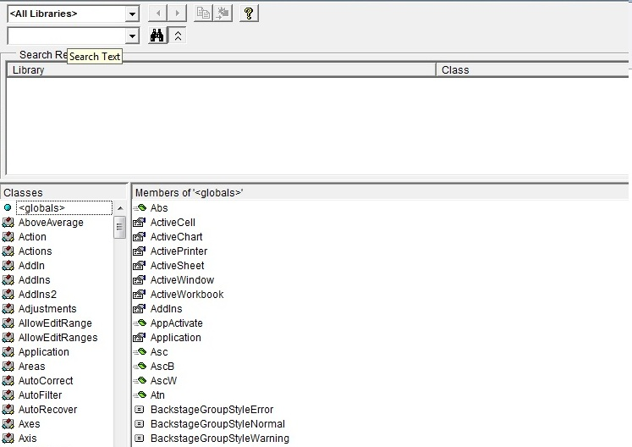
Macros Help and Assistance

Slide 44
Events
Starting, Triggering
a Macro
trigger [`trɪgə(r)] - wywoływać, powodować, inicjować

Slide 45
EVENTS
When does the VBA procedure (macro) start? When an EVENT happens.
The event is what triggers the VBA Excel procedure. You have used an event to start your macros. In the VBE you have gone to the menu bar and clicked on "Run/Run Sub/Userform" and the macro was executed. You have also clicked on the F8 key at the top of your keyboard and the macro got executed line by line.
You do not want your user to go to the VBE to trigger a macro. A lot of other events can happen to start a macro. The event that is mostly (85%) of macros used is clicking on a button. The button can be on the worksheet or on a user form that you would develop. The event can also be: opening the workbook, selecting a sheet, the value of a cell changing due to a manual input or due to the recalculation of a formula, clicking on a selected keystroke or going to the right menu item in Excel.
Preparing the Exercise on Events
To complete the following exercises, copy the code below to the code window of "Sheet1" of the new Excel workbook.
Sub proFirst()
Range("A1" ).Value = 34 Range("A2" ).Value = 66 Range("A3" ).Formula = "=A1+A2"
Range("A1" ).Select
End Sub

Slide 46
Macros Triggered from ... by ...
Macros Triggered from the Developer Ribbon
Step 1: Select "Macros" from the "Developer" ribbon. You will see the "Macro" dialog window below.
Step 2: "Sheet1.proFirst" being selected in the list box and its name appearing in the text box above the list box just click "Run". The macro is automatically executed
Step 3: Erase the contents of cells A1, A2 and A3
You now see that colleagues must have installed VBA on their own computer to be able to use your macros from the "Developer" ribbon.
Macros Triggered by a Keystroke
In this second first exercise on events we will get the macro to be keyboard activated by capital "s" (Shift/S). First you need to program a key. To do so:
Step 1: Select "Macros" from the "Developer" ribbon. You will see the "Macro" dialog window below.
Step 2: "Sheet1.proFirst" being selected in the list box and its name appearing in the text box above the list box just click on "Options". A new dialog window "Macro Options" appears:
Step 3: In the shortcut key text box enter a capital "s" and then click "OK". Click "Cancel" in the dialog window
Step 4: If you now click "CTRL/SHIFT/S" the macro will be executed instantly.
Notes:
trigger (off) [`trɪgə(r)] wywoływać, powodować, inicjować; spust, język spustowy, przerzutnik

Slide 47
Macros Triggered on ...
Macros Triggered by Clicking on a Text Box on the Worksheet
More than 90% of the macros are triggered by a click on a button located on a worksheet
We prefer using text boxes rather than VBA command buttons because they are much easier to maintain and allow much more creativity in the design. You can use the font that you like and the background color that fits your needs. If you are a little creative you can add 3D effects, special borders and others.
Step 1: From the "Insert ribbon" click on the "Text Box" icon once. Lower the curser toward the sheet, click and hold the left button of the mouse and stretch the text box to the desired dimension.
Step 2: Right click on the text box, select "Assign Macro" from the menu and the "Assign Macro" dialog window appears:
Step 3: Select "Sheet1.proFirst" from the list box and its name appears in the text box above the list box just click on "OK".
Step 3: Click away from the text box on the Excel sheet.
Step 4: Left click on the text box and the macro is executed.
Step 3: Select "Sheet1.proFirst" from the list box and its name appears in the text box above the list box just click on "OK".
Step 3: Click away from the text box on the Excel sheet.
Step 4: Left click on the text box and the macro is executed.
Notes:
trigger (off) [`trɪgə(r)] wywoływać, powodować, inicjować; spust, język spustowy, przerzutnik

